Slide 1
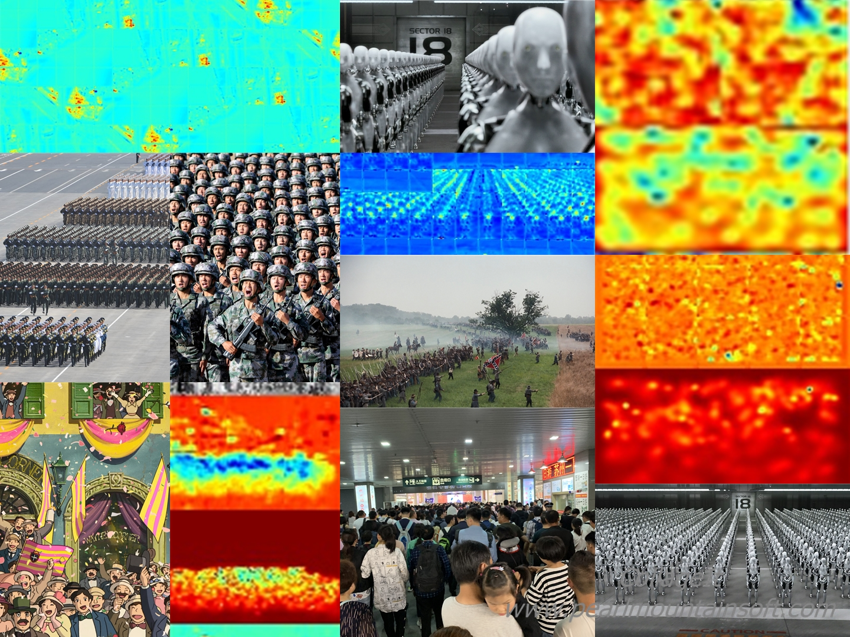
监控场景下
基于深度学习的
人群密度估计

Slide 2
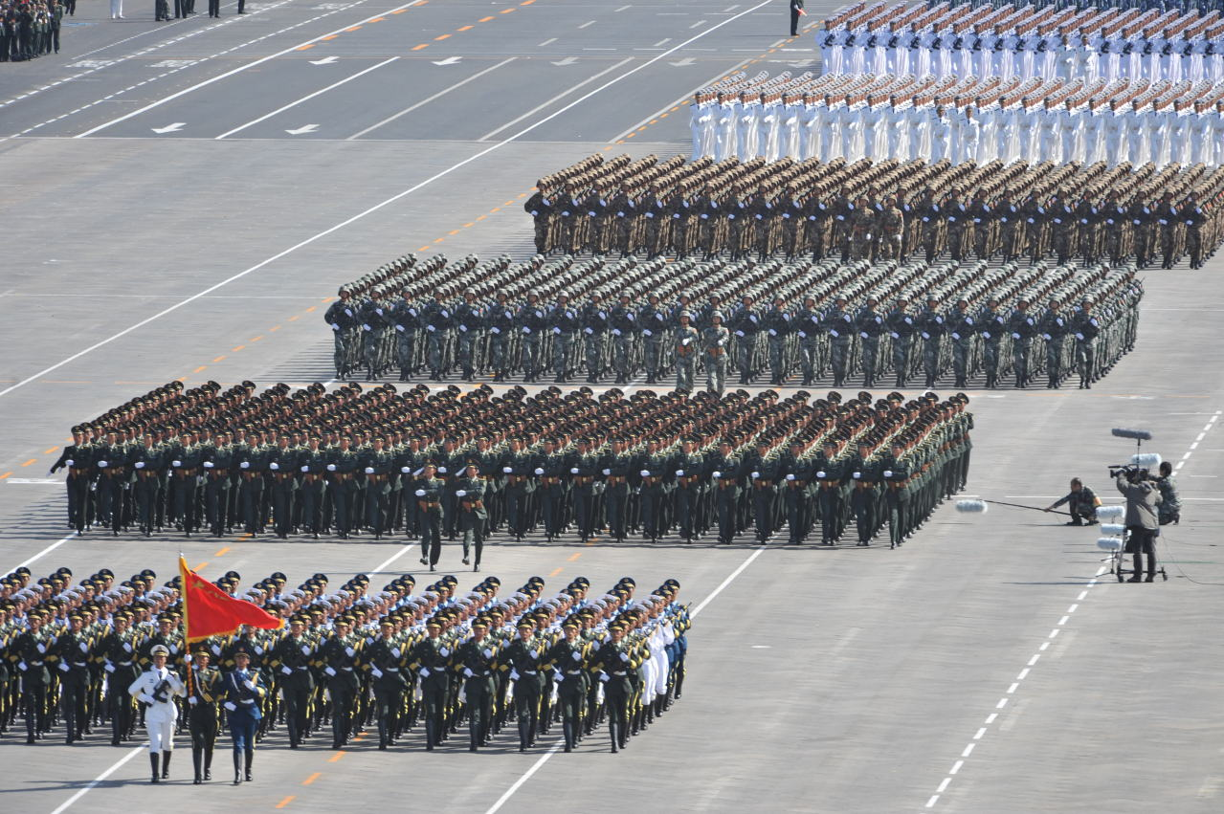
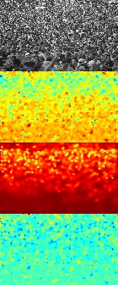
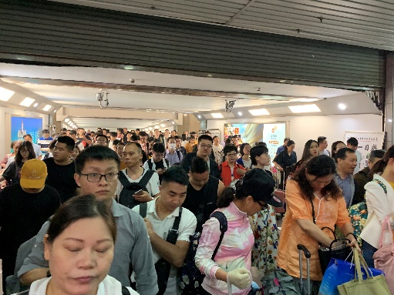
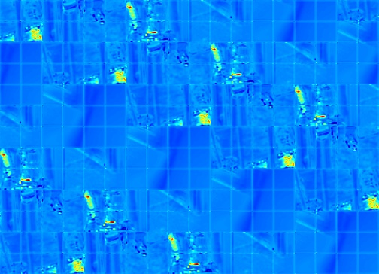
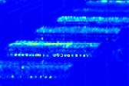
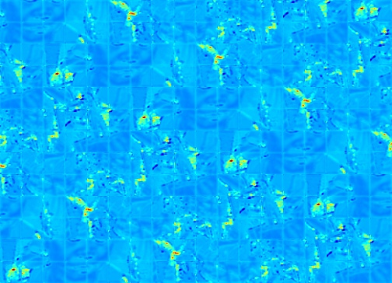
Introduction

Slide 3

Dataset & Ground Truth

Slide 4
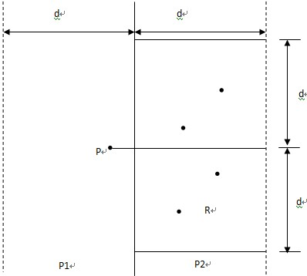
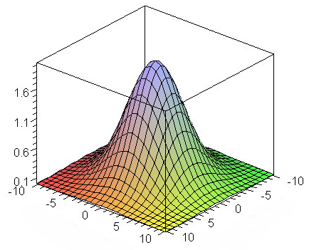
Generate Ground Truth

Slide 5
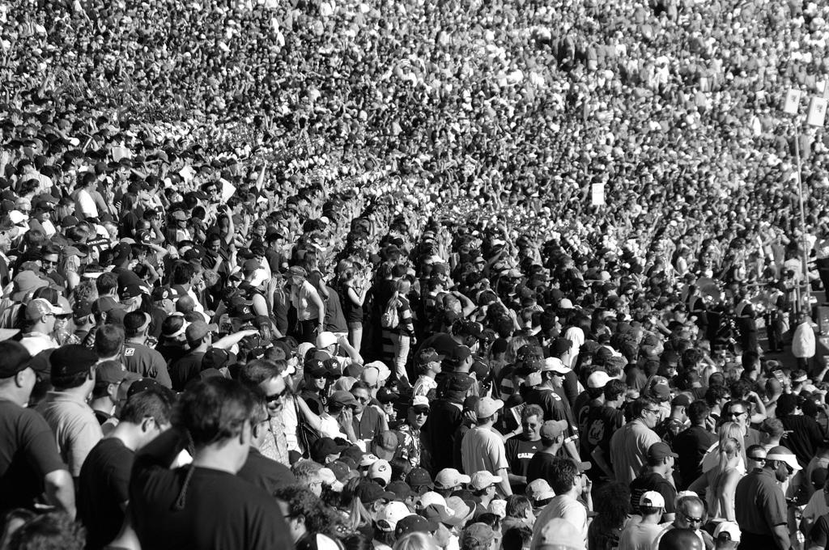
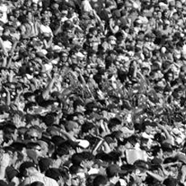
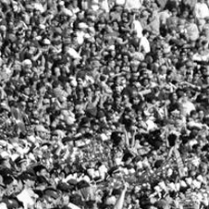

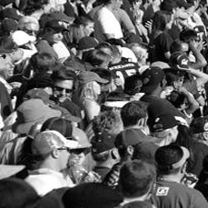

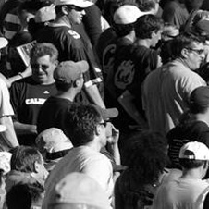
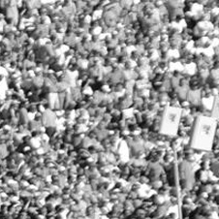
Data Argumentation
Crop & Flip
Sample
Pos vs Neg

Slide 6
Data Argumentation
multi-scale pyramidal

Slide 7
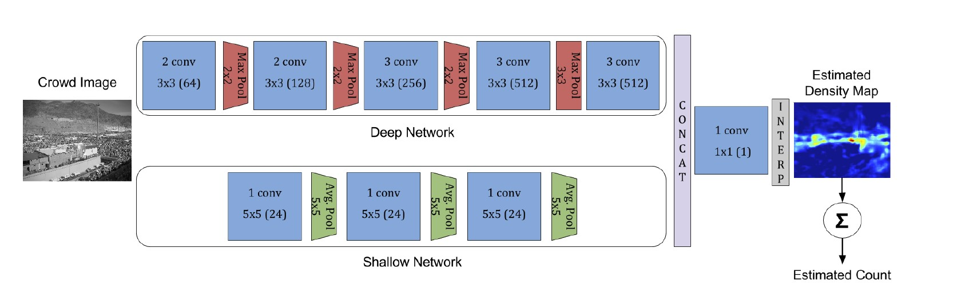
Network Architecture

Slide 8
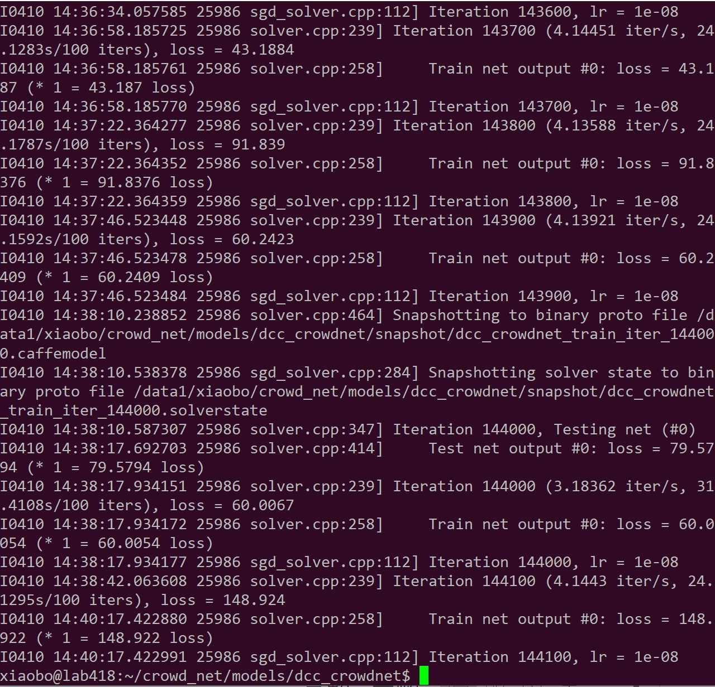
Training
GPU 1080Ti
batch size = 10
140000+ iteration
(about 47 epoch)
type: SGD
lr_policy: “step”
gamma: 0.1
stepsize: 100000
weight_decay: 0.0005

Slide 9
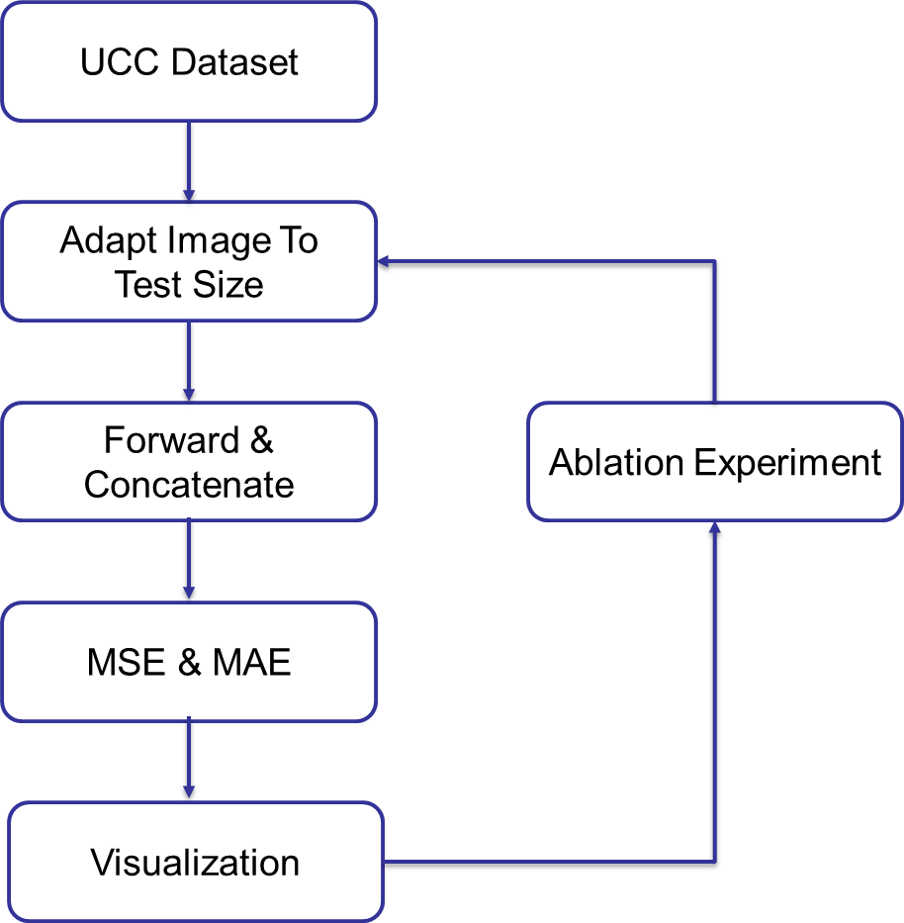
Experimentation

Slide 10
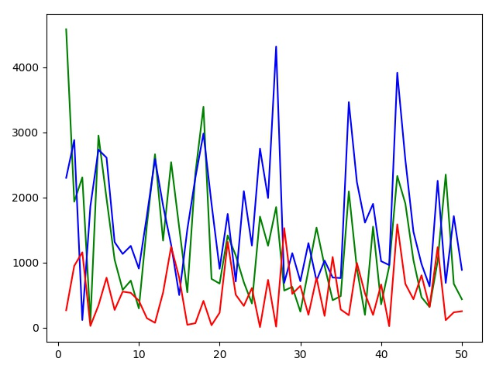
Experimentation
MAE: 521.9
MSE: 669.5

Slide 11
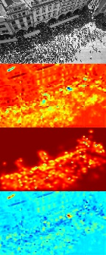
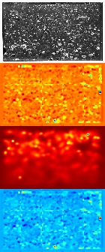
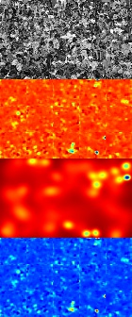
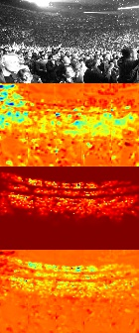
Visualization

Slide 12
Ablation Experiments
5-fold test result: more experiments needed
Shallow Network | MAE | MSE
Off | 583.6 | 784.2
On | 551.8 | 699.5

Slide 13
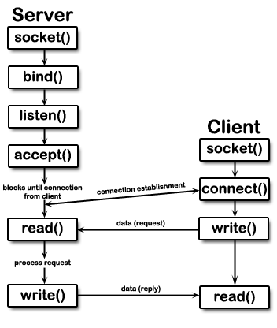
Deployment
TCV vs UDP
Buffer Issue
fps
Network packet loss
Multithreading

Slide 14
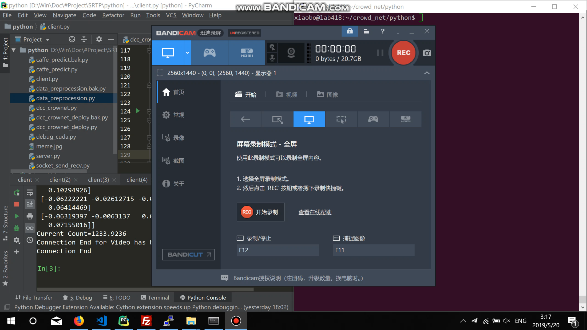
Video Demo

Slide 15
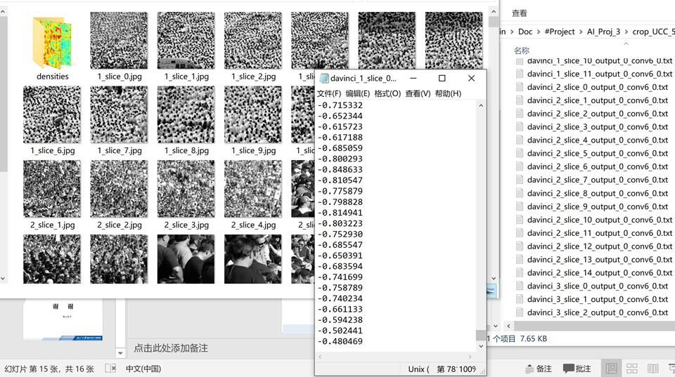
Problems Encountered

Slide 16
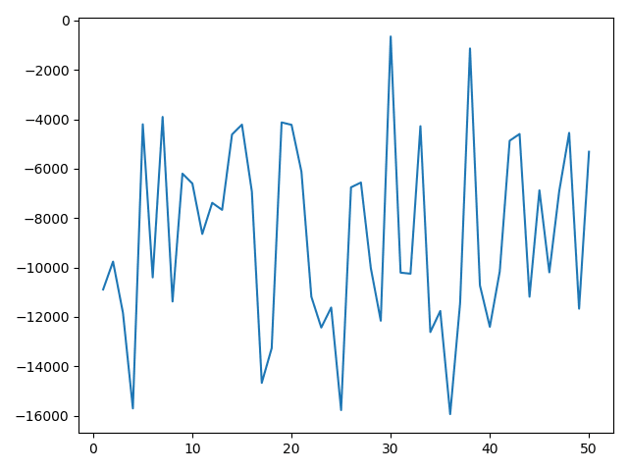
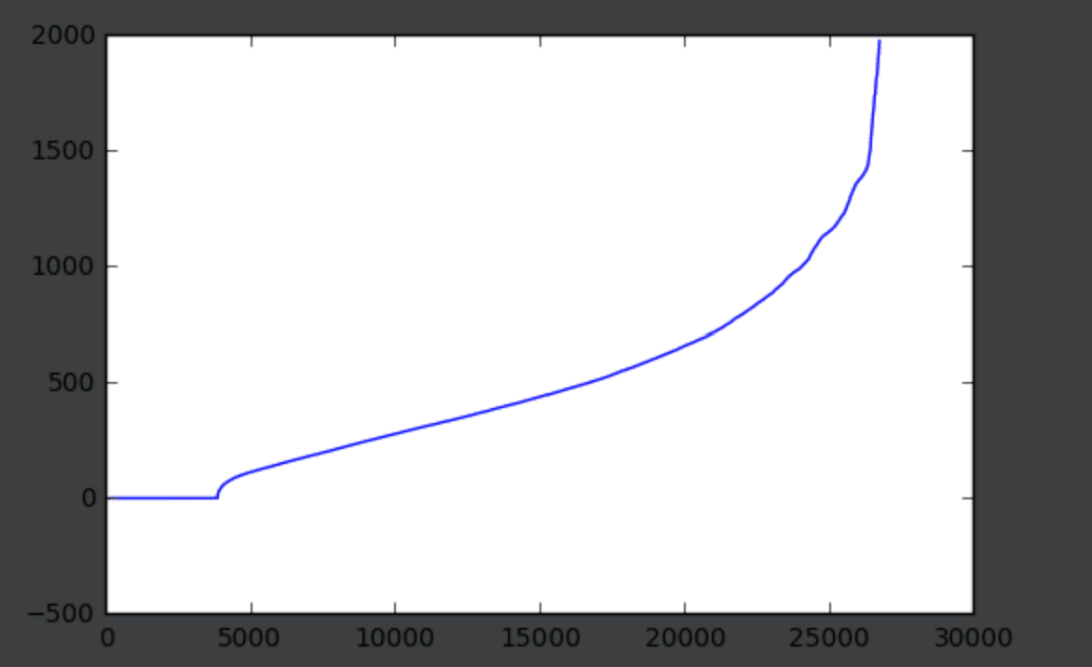
Problems Encountered

Slide 17
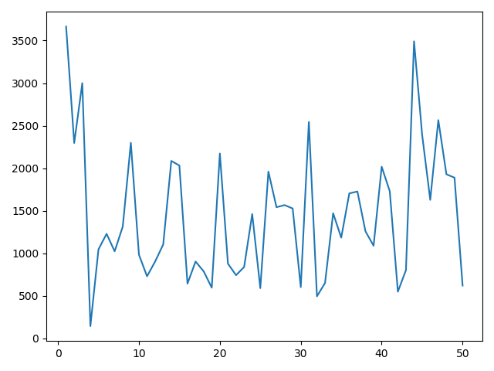
Problems Solved!

Slide 18
THANK YOU

